Slide 1
Azure Networking

Slide 2
Azure Overview

Slide 3

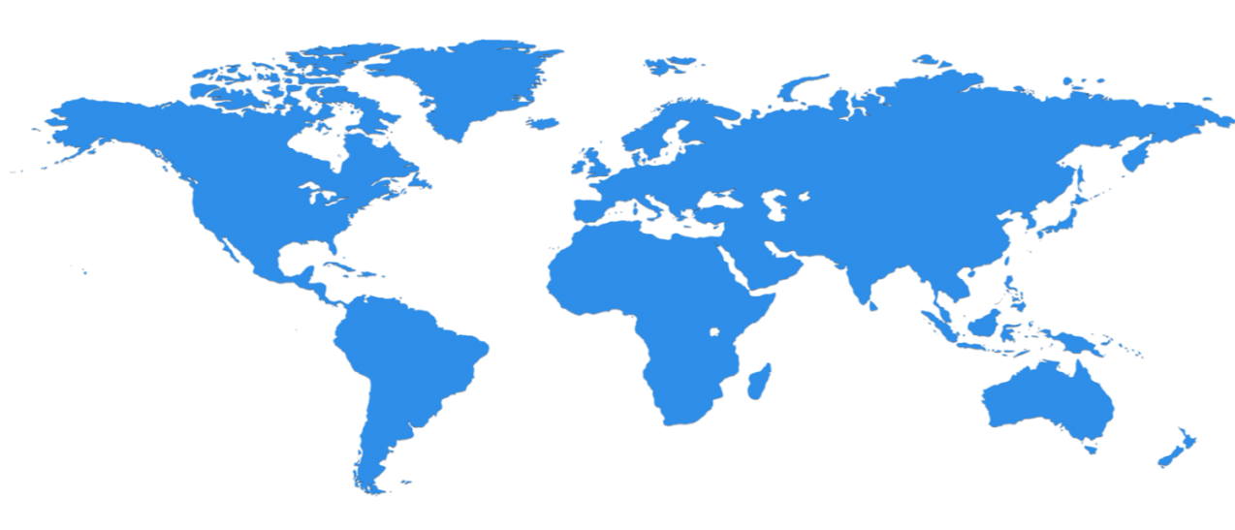

Azure Global Footprint
34 Regions Online, 3 Additional Regions Planned
UK West, UK South
Germany North East,
Germany Central
North Central US
Illinois
Canada
Quebec 2016
North Europe
Ireland
West Europe
Netherlands
Central US
Iowa
Canada
Toronto 2016
China South
Shanghai
China North
Beijing
US Gov
Iowa
East US
Virginia
India Central
Pune
IND EA
Japan East
Saitama
West US
California
India South
Chennai
IND EA
East US 2
Virginia
France
2017
Japan West
Osaka
West US 2
US Gov
Virginia
India West
Mumbai
IND EA
West Central US
S. Korea
2 Regions 2017
South Central US
Texas
East Asia
Hong Kong
SE Asia
Singapore
Australia East
Sydney
ANZ EA
Brazil South
Sao Paulo
Australia West
Melbourne
ANZ EA
100+ datacenters
One of the top 3 networks in the world (coverage, speed, connections)
Public Azure
Planned
US Gov Cloud
Operated by 21Vianet

Slide 4








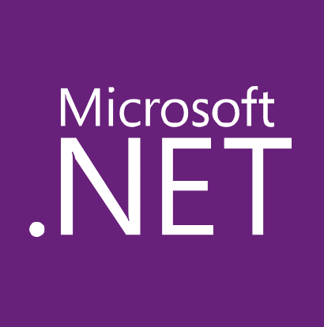











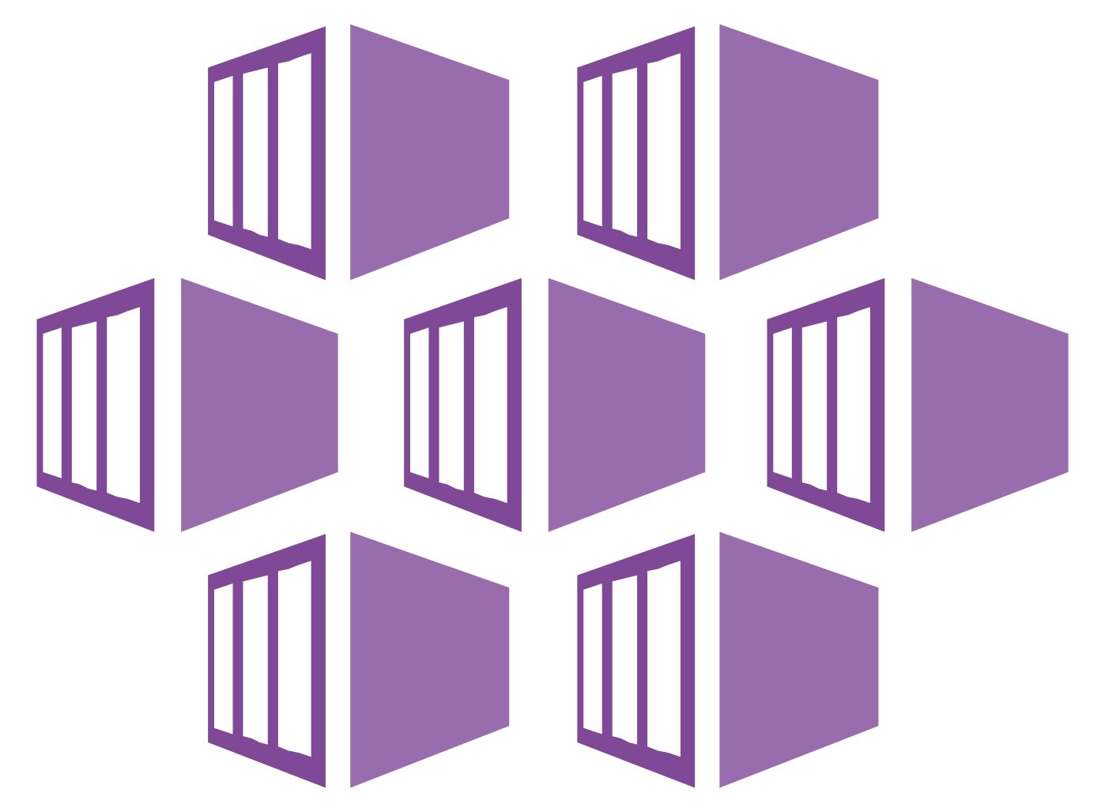
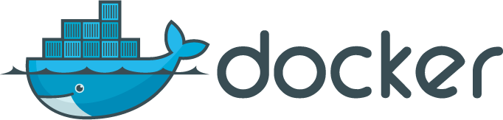



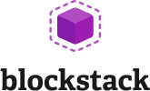



Build and run open source solutions
Any tool, application, framework
Applications
DevOps
Frameworks
Databases & middleware
Containers
Infrastructure

Slide 5
Microsoft Azure : Shared Responsibility
Microsoft Azure
(On-Premises)
Infrastructure
(as a Service)
Platform
(as a Service)
Software
(as a Service)
Applications
Applications
Applications
You manage
Applications
Data
You manage
Data
Data
Data
Runtime
Runtime
Runtime
Runtime
Managed by vendor
You manage
Middleware
Middleware
Middleware
Middleware
Managed by vendor
O/S
O/S
O/S
O/S
Virtualization
Managed by vendor
Virtualization
Virtualization
Virtualization
Servers
Servers
Servers
Servers
Storage
Storage
Storage
Storage
Networking
Networking
Networking
Networking
Most Flexible
Lowest Cost
Lift and Shift
Build New Apps

Slide 6

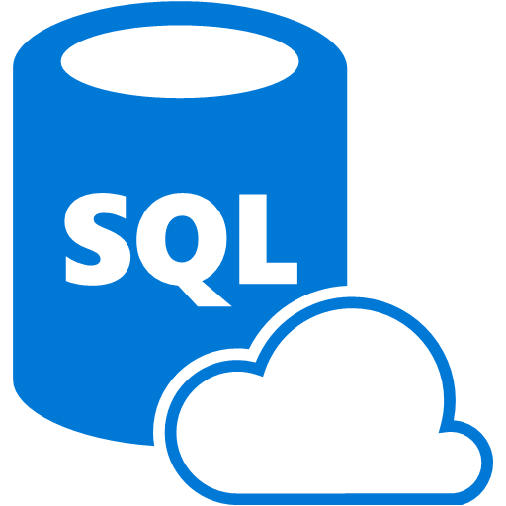


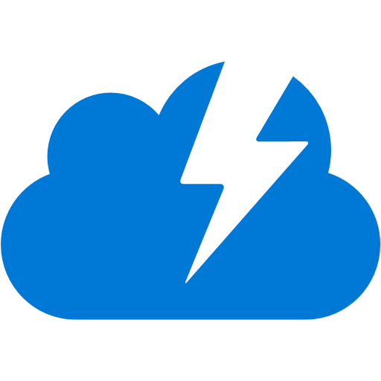

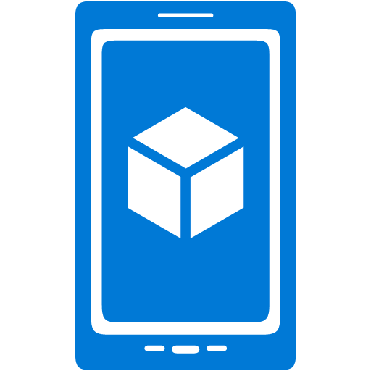


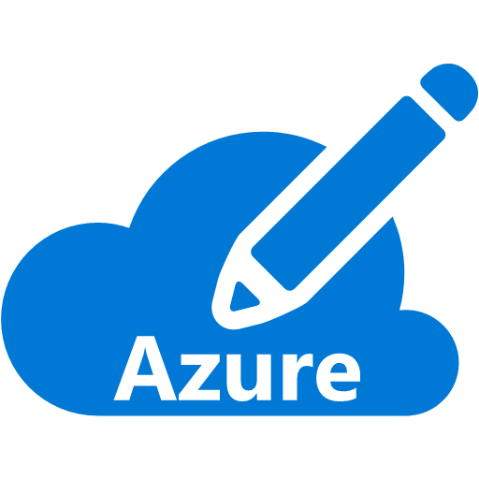




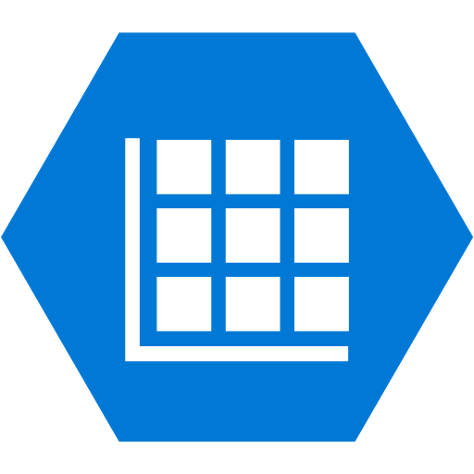
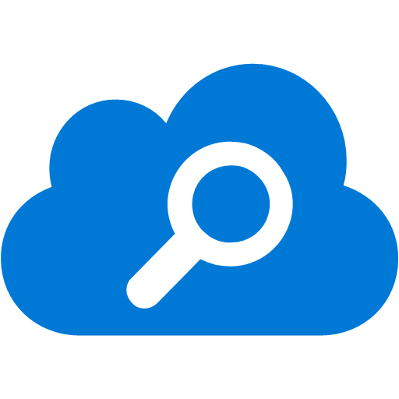

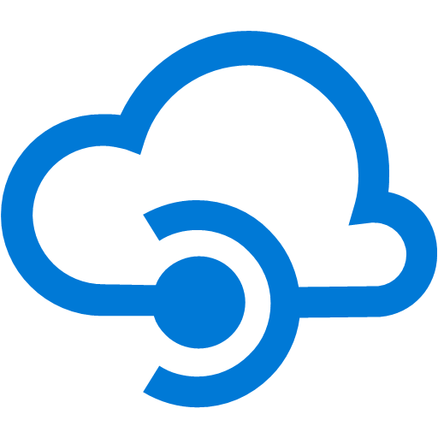
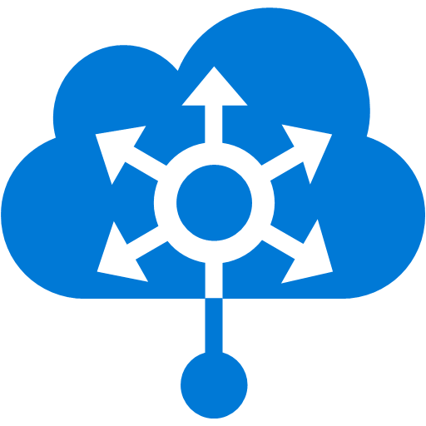



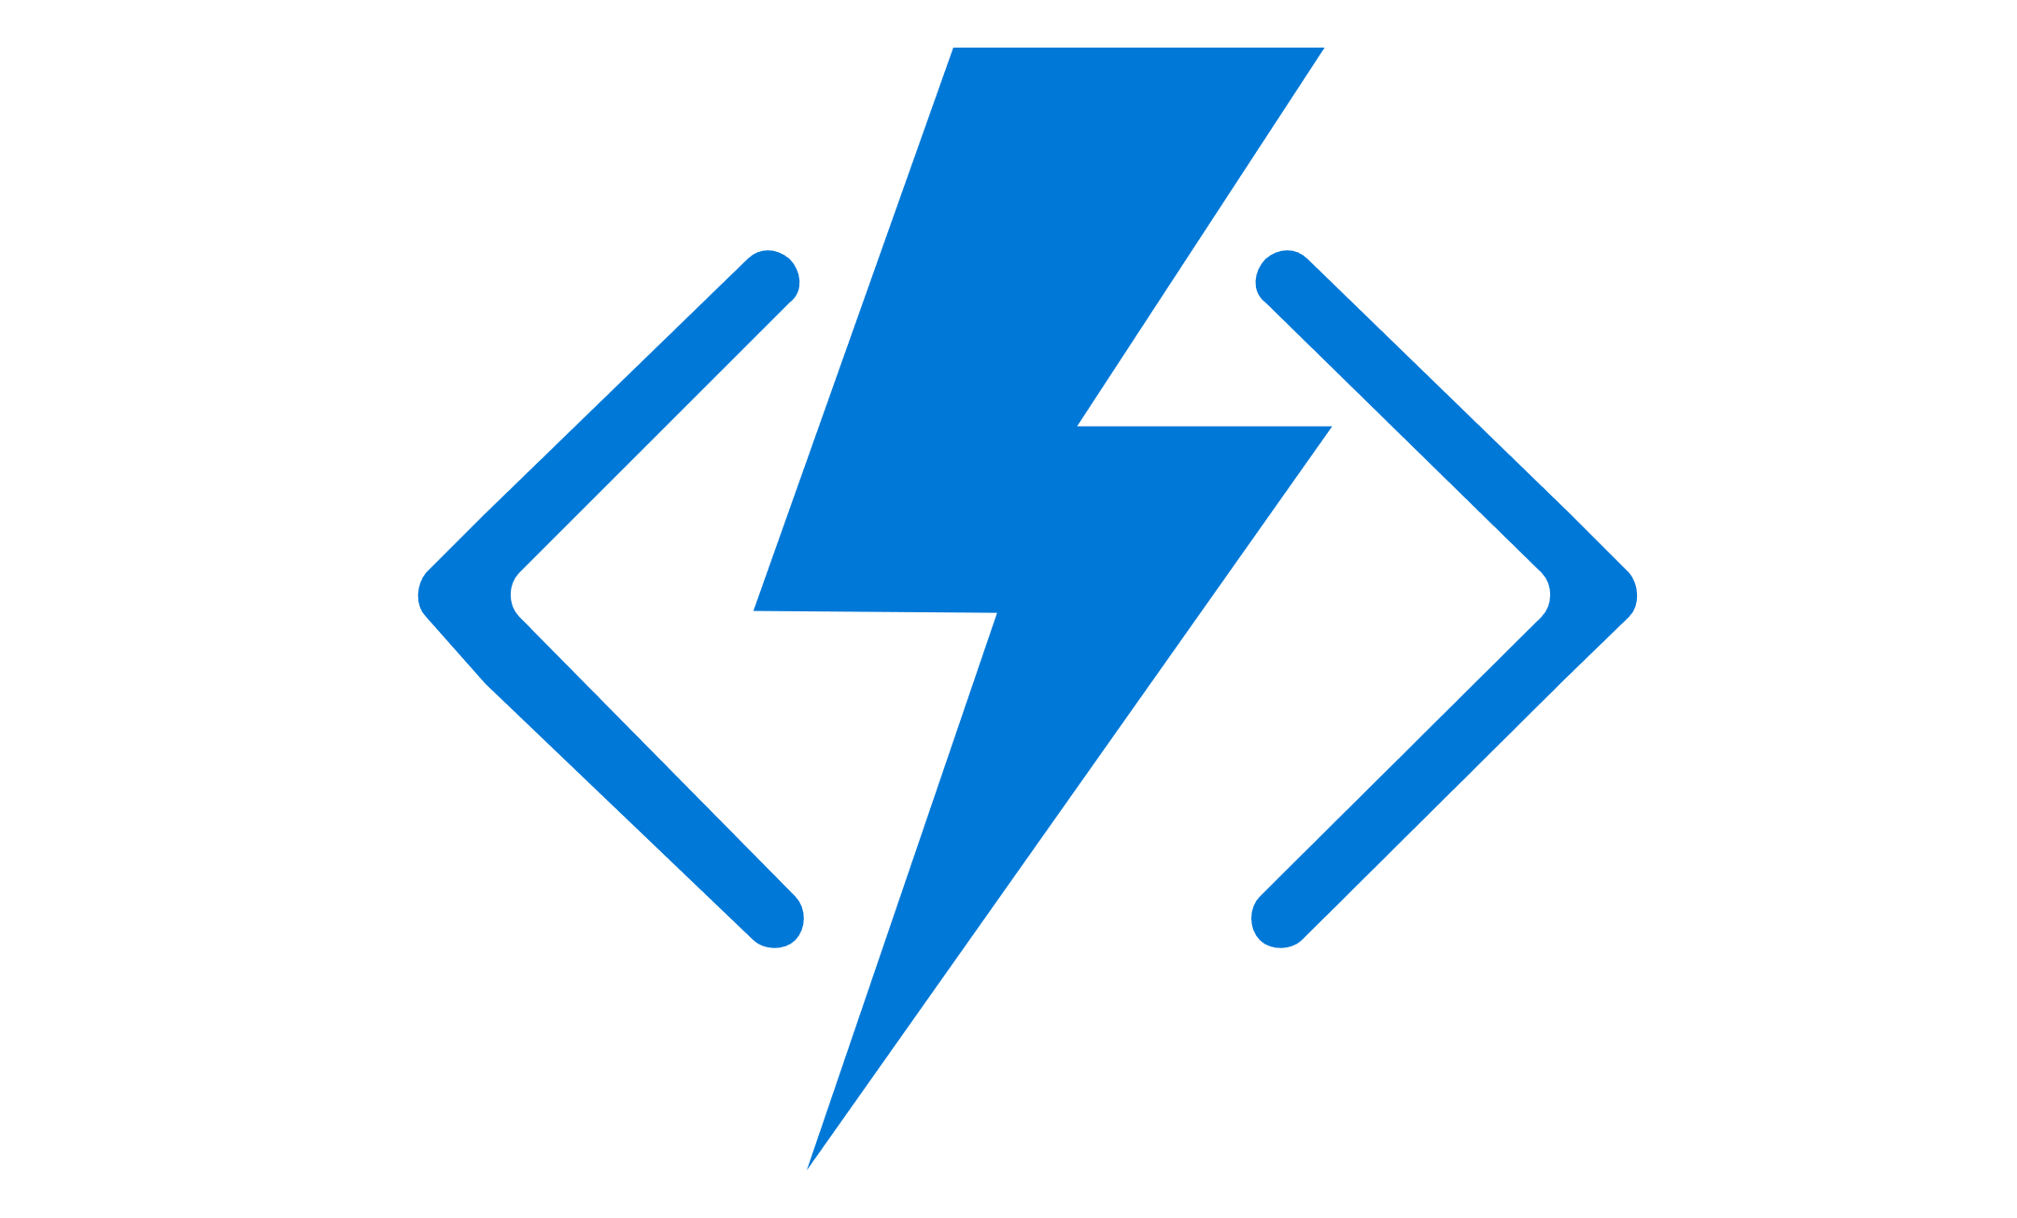



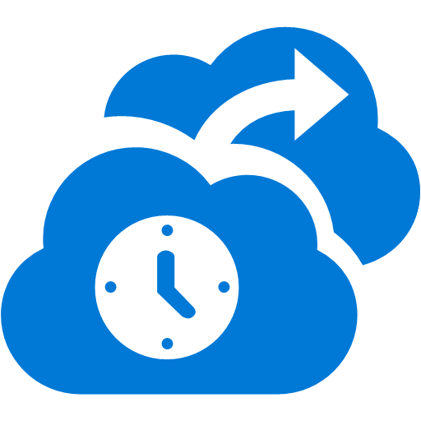







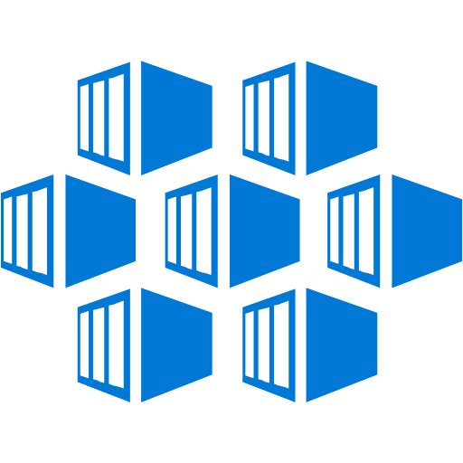
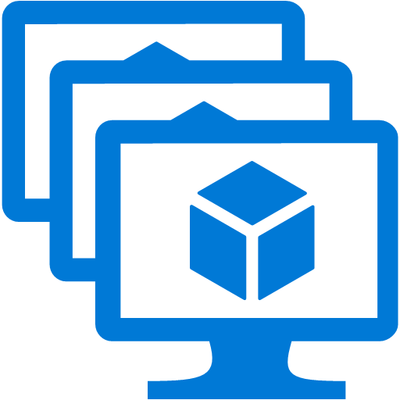


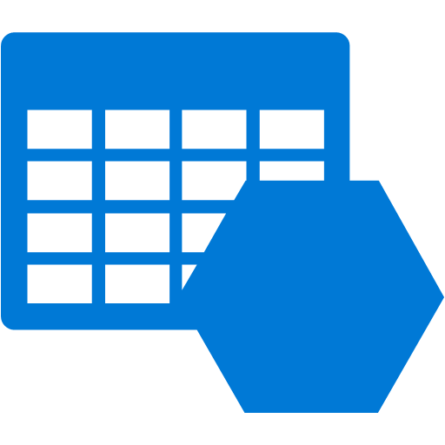



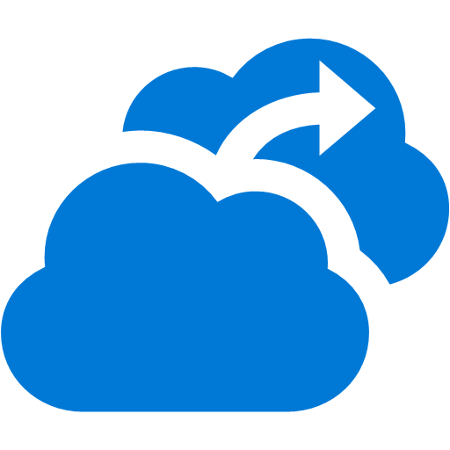

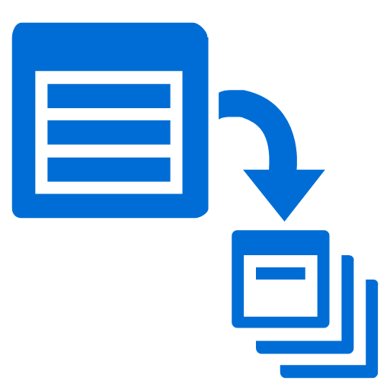




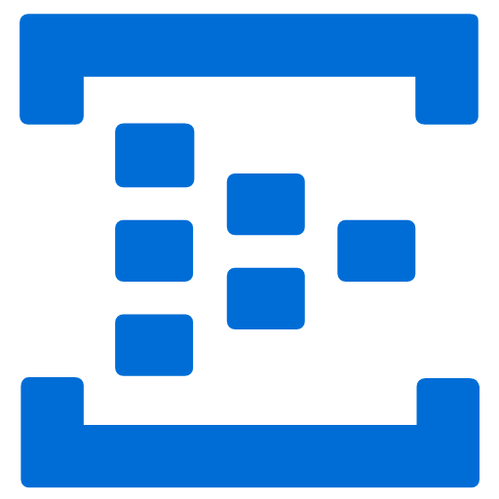





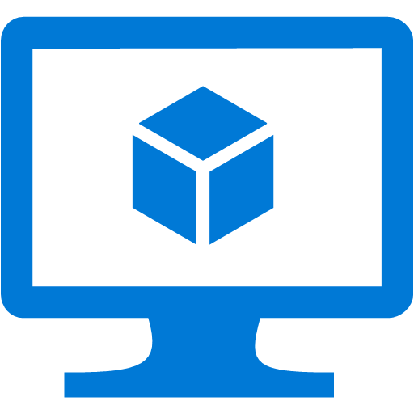
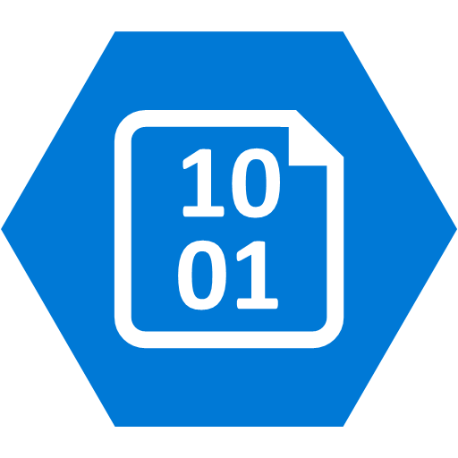


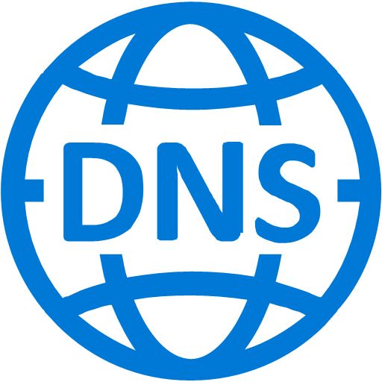
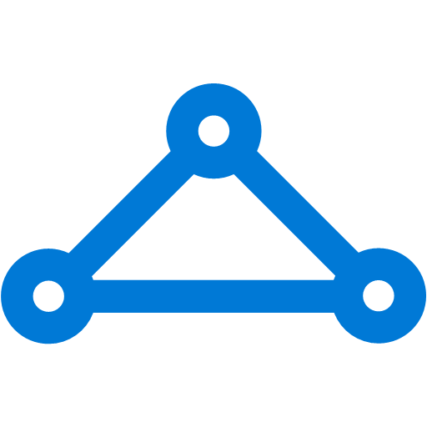


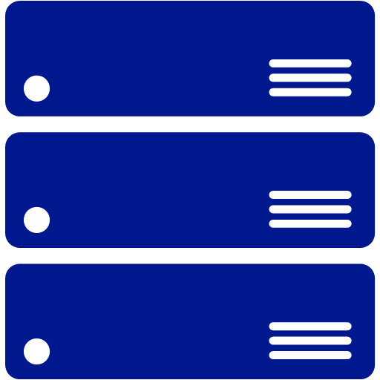
Platform Services
Security & Management
Hybrid
Cloud
Media & CDN
Application Platform
Data
Security Center
SQL
Database
Azure AD
Health Monitoring
Media Services
Media Analytics
Content Delivery
Network
Web
Apps
Mobile
Apps
SQL Data
Warehouse
DocumentDB
Portal
AD Privileged
Identity
Management
Azure Active
Directory
Integration
SQL Server
Stretch Database
Redis
Cache
Storage
Tables
Azure
Search
API
Apps
Cloud
Services
Azure AD
B2C
API
Management
BizTalk
Services
Domain Services
Service
Fabric
Notification
Hubs
Intelligence
Multi-Factor
Authentication
Logic
Apps
Cognitive Services
Bot Framework
Cortana
Backup
Interactive overview of Azure Platform
http://azureplatform.azurewebsites.net
Service Bus
Functions
Automation
Developer Services
Analytics & IoT
Operational
Analytics
Compute Services
Scheduler
HDInsight
Machine
Learning
Stream Analytics
Container
Service
VM
Scale Sets
Visual Studio
Mobile
Engagement
Import/Export
Key Vault
Data
Catalog
Data Lake
Analytics Service
Data Lake Store
Store/
Marketplace
Batch
RemoteApp
VS Team Services
Xamarin
Azure Site
Recovery
Application
Insights
HockeyApp
IoT Hub
Event
Hubs
Data
Factory
Power BI
Embedded
VM Image Gallery
& VM Depot
Dev/Test Lab
StorSimple
Infrastructure Services
Compute
Storage
Networking
Virtual Machines
Containers
Blob
Queues
Files
Disks
Virtual Network
Load Balancer
DNS
Express
Route
Traffic Manager
VPN Gateway
App
Gateway
Datacenter Infrastructure (34 Regions Online)

Slide 7
Azure Networking

Slide 8
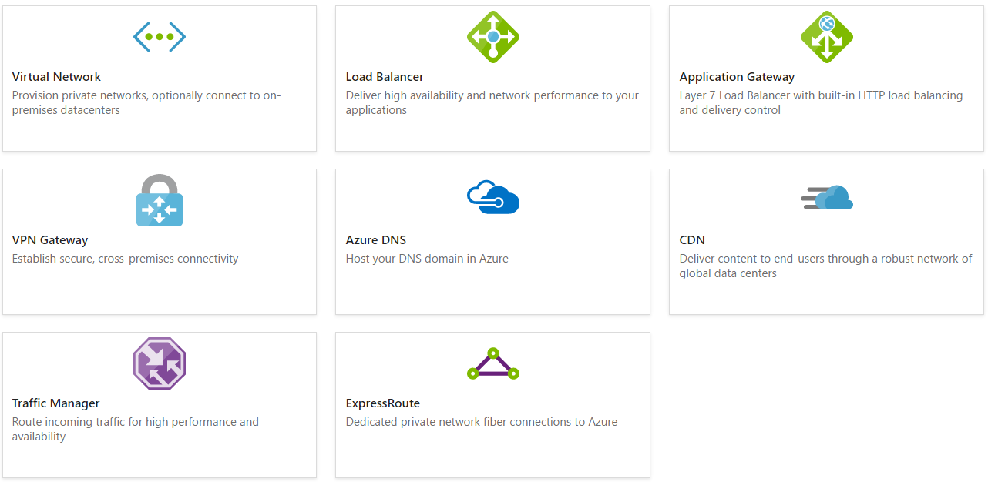
Azure Networking
https://docs.microsoft.com/en-us/azure/#pivot=services&panel=network

Slide 9

Virtual Networks (vNets)
Build your own Cloud DC
Bring your own IP addresses and DNS Servers
Accelerated Network in Preview provides up to 25Gbps
vNets can be linked and inter-vNet traffic remains in Azure
Native IPv6 Support for Azure Virtual Machines
Connect PaaS and IaaS to your existing DCs
vNets are completely isolated from each other
https://azure.microsoft.com/en-us/documentation/articles/virtual-networks-overview/
http://go.microsoft.com/fwlink/?LinkId=296833 (vNet Security Whitepaper)

Slide 10
Subnets
Allow you to divide your vNet for Organisation & Security
Every vNet has at least one Subnet
By default any VM / PaaS resource deployed can talk to any other resource in any subnet in the same vNet
VPN Gateways use a special subnet “GatewaySubnet” is created – you need to leave IP Addresses for this!

Slide 11
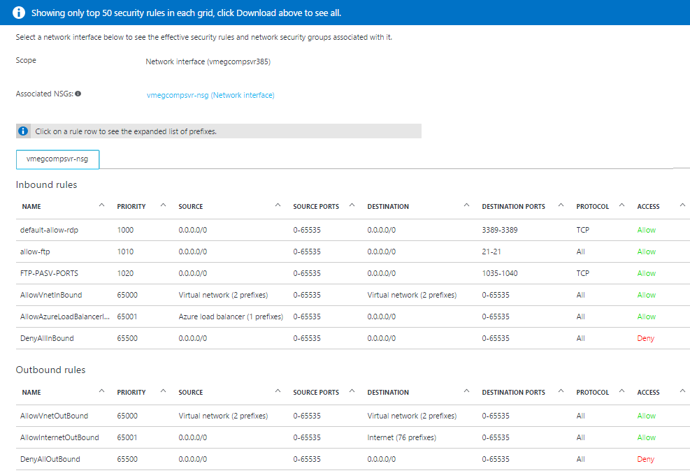
Network Security Groups
Access Control List to Allow / Deny network Traffic
Can be associated with a Subnet or VM Network Card (NIC)
Define Source IP & Port, Destination IP & Port & Protocol
Rules Processed in Order
Can use the Effective security rules blade in the Portal to see applied rules for a NIC
Integrated with Azure Security Center
Integrate with OMS Log Analytics
https://azure.microsoft.com/en-gb/blog/network-security-groups/

Slide 12
Connecting to your users
Basic Building Blocks enable building of traditional deployments

Slide 13
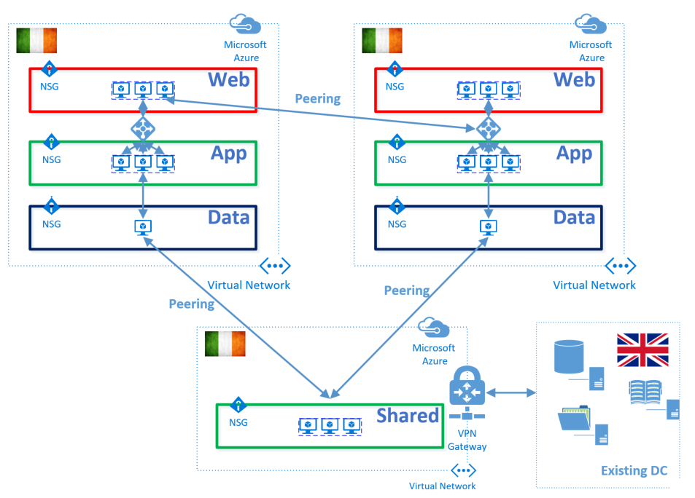
Peering
Connect multiple vNets together in the SAME region
Peering can span Subscriptions
Low Latency / High bandwidth connection
Enables “Shared” resource models for operational / cost benefits

Slide 14
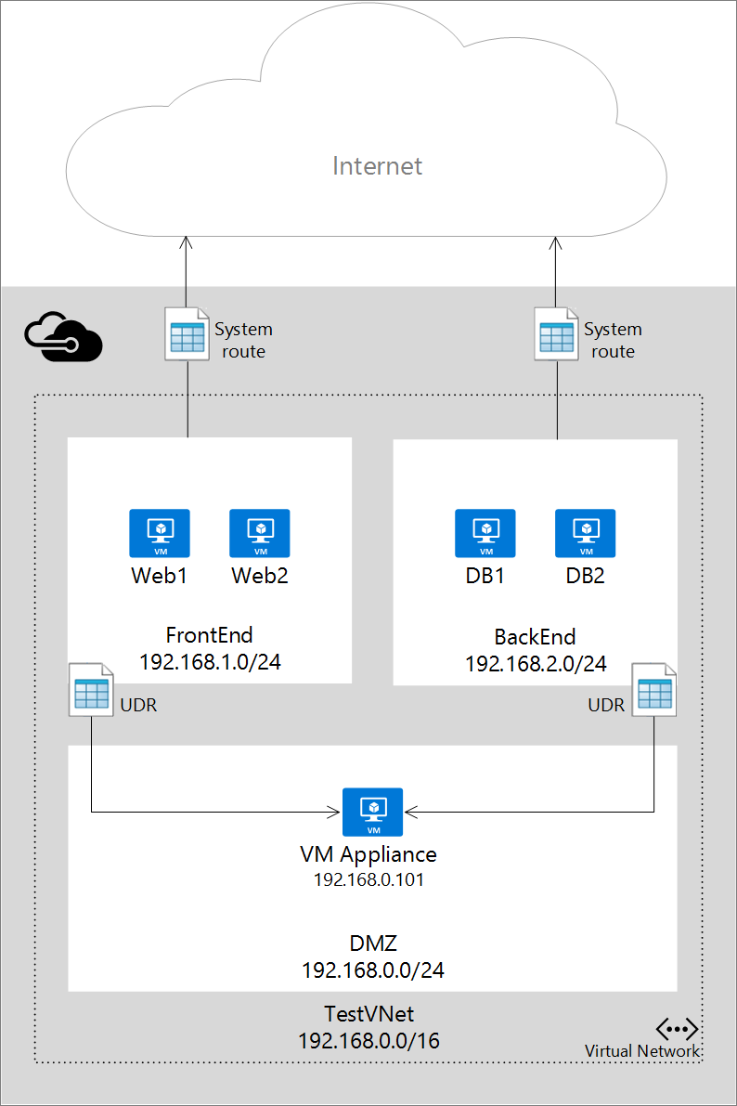
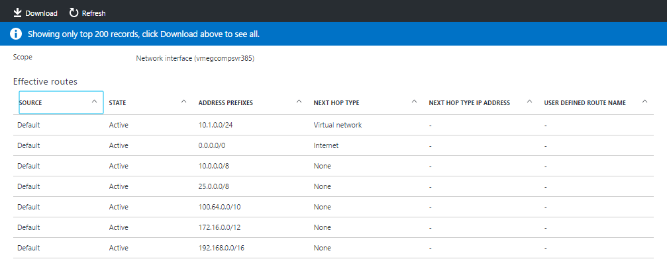
User Defined Routing (UDR) & Network Virtual Appliances
Define your own Routes
Supports “Forced Tunnelling” for ensuring all traffic goes via existing WAN
Can view applied routes via Effective Routes blade in Portal
With “IP Forwarding” enables Network Virtual Appliances (NVAs)
NVAs can provide more sophisticated functionality, e.g., Firewalls / Load Balancers
NVAs can integrate with Security Center
Marketplace contains familiar names reducing the need for support teams to maintain multiple products
https://docs.microsoft.com/en-us/azure/virtual-network/virtual-networks-udr-overview

Slide 15

Load Balancers
Load Balance Public and Internal Workloads
Supports IPv6
Improve Reliability with Health Checks
Enables Port Forwarding
Integrated with VM Scale Sets
Supports balancing across multiple ports, multiple IPs or both
https://azure.microsoft.com/en-us/documentation/articles/load-balancer-overview/

Slide 16

Traffic Manager
Supports on-premises and Cloud
Improve responsiveness by routing to best performing region
Enables A/B testing of deployments
Supports Failover of apps across regions
SLA 99.99%
https://azure.microsoft.com/en-us/documentation/articles/traffic-manager-overview/

Slide 17

Content Delivery Network (CDN)
Multiple Providers: Akamai & Verizon – enables selection of CDN for you and balancing across CDNs
Certified to highest FedRAMP Joint Authorization Board (JABs)
Real Time Analytics (Premium)
Improved performance for Customers by serving content from nearest “edge” server
Advanced Rule Engine (Premium)
SLA 99.9%
https://docs.microsoft.com/en-gb/azure/cdn/cdn-overview
https://azure.microsoft.com/en-gb/documentation/articles/cdn-pop-locations/

Slide 18

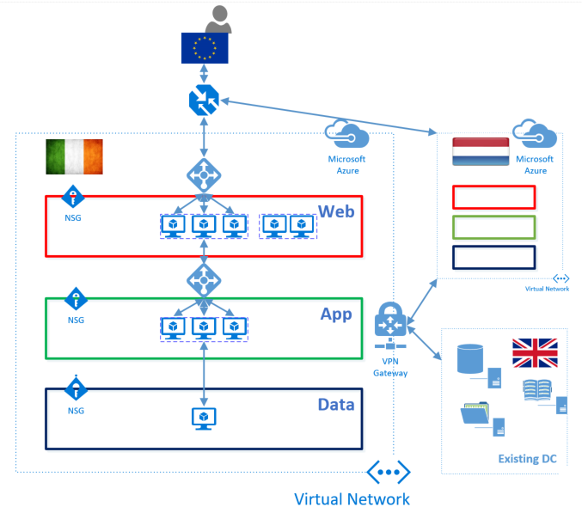
VPN Gateway
Industry Standard IPSec Site-to-Site VPNs
Point-to-site VPN
99.9% uptime SLA
Connect your vNets to your existing investments or vNets in other Azure Regions
100Mbps – 200Mbps gateway throughput
500Mbps – 2000Mbps ExressRoute throughput
Supports Active / Active S2S (High Perf SKU)
BGP Support

Slide 19

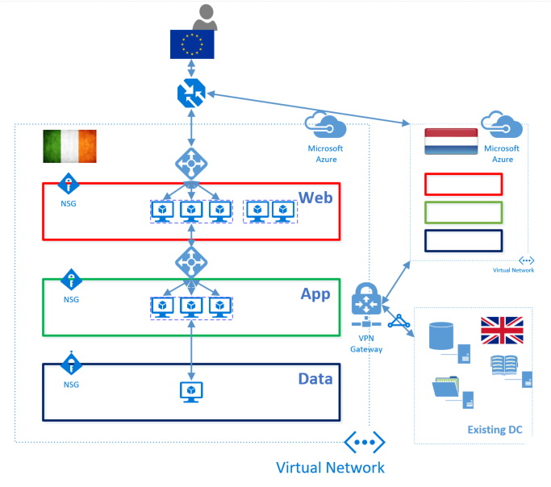
ExpressRoute
Provides private connection to Azure from your infrastructure – your data does not go via the internet
50 Mbps – 10Gbps
Lower Latency
Route both traffic to your vNets and traffic to public Azure services over ExpressRoute
SLA 99.95%
Connect via dedicated routers or add on to your existing WAN
ExpressRoute PoP gives access to whole “Geopolitical region – e.g., London = Europe N/W and UK W/S
ExpressRoute Premium gives access from PoP to all Regions (except national clouds)
https://azure.microsoft.com/en-us/documentation/articles/expressroute-introduction/

Slide 20

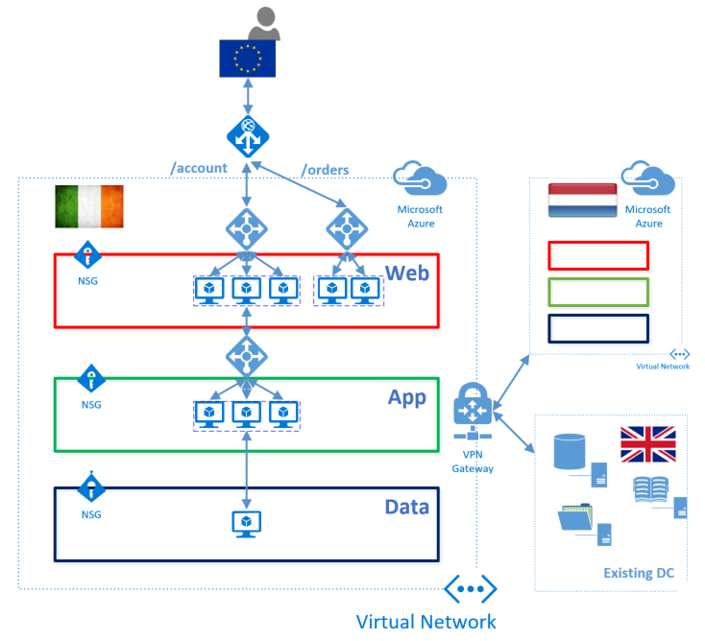
Application Gateway
URL based routing
Provides Cookie affinity
Public & Private websites
SSL offload
Health monitoring
99.9% uptime (multi-instance)
Integrated with VM Scale Sets
WAF (Preview) includes SQL injection, & OWASP top 10 common web vulns

Slide 21
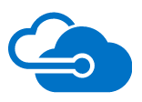

DNS
Global network of name servers provide fast DNS responses
Anycast ensures requests go to nearest DNS servers
Host and manage your domain from the Azure Portal
SLA 99.99%

Slide 22
The Big Network Picture
Virtual Network
“Bring Your Own Network”
Segment with subnets and Network Security Groups
Control traffic flow with User Defined Routes
Azure
Virtual Network
Users
Internet
Front-End Access
Dynamic/Reserved Public IP addresses
Direct VM access, ACLs for security
Load balancing
DNS services: hosting, traffic management
DDoS protection
Backend Connectivity
Point-to-site for dev / test
VPN Gateways for secure site-to-site connectivity
ExpressRoute for private enterprise grade connectivity
S2S
VPN
ExpressRoute

Slide 23
Connecting to Virtual Networks
Cloud-only virtual networks
Use endpoints to connect to specific services
Point-to-site VPNs
Use a VPN to connect from a single computer
Site-to-site VPNs
Use a VPN to connect from an on-premise subnet
ExpressRoute
Connect directly without going over the Internet
Notes:
20533B
2: Implement and Manage Virtual Networks

Slide 24

Site-to-Site Connectivity
Extend on-premises to the cloud securely (IPSec)
On-ramp for migrating services to the cloud
Use on-prem resources in Microsoft Azure (monitoring, AD, etc.)
Microsoft Azure
Site-to-Site VPN
Virtual Network
WFE
App
SQL
DC/DNS
On-premises
VPN Gateway
VPN Gateway
Hardware VPN or Windows RRAS
Your datacenter
Point-to-Site VPN
Individual computers behind corporate firewall
Remote workers

Slide 25

Point to Site connectivity
Microsoft Azure
Connect from anywhere securely
Secure Sockets Tunneling Protocol (SSTP)
Easy to setup and use
Ideal for prototyping, dev, & demos
P2S and S2S coexist
Virtual Network
WFE
App
SQL
DC/DNS
VPN Gateway
VPN Gateway

Slide 26
ExpressRoute Connectivity
Predictable performance
Security
High throughput
Branch office 2
Microsoft
WAN
Branch office 1
Public internet
Corp HQ
ExpressRoute provides a private, dedicated, high-throughput network connection to Microsoft

